Slide 1
HPHA Waitlist opening HCV – March 22-26th Project-Based – March 29-31st
Important Information

Slide 2
Open Waitlists
Housing Choice Voucher Waitlist
Preference: Families with a non-elderly disabled family member
Opening: March 22-26th
Palolo Project-Based Waitlist
Preference: Families with a non-elderly disabled family member
Only accepting families who qualify for a 4-bedroom unit
Opening: March 29-31st

Slide 3
Lottery Selection
HCV Waitlist – 1,000
Palolo-Project Based – 200
Randomly select from the pool of applicants who will be placed on the waitlist
Waitlist order will be randomly assigned
All applicants will be contacted via email stating whether they made it onto the waitlist or not
No appeal process for applicants who did not make the waitlist
Waitlist will expire on May 1. All those still on the waitlist or who have not been issued a voucher will be cancelled.

Slide 4
Applicant Information

Slide 5
Qualifications – Non-Elderly Disabled Preference
The applicant must have a member of the family who:
Is at least eighteen (18) years of age, but not yet sixty-two (62), AND
That family member has a disability
The non-elderly, disabled family member can be the:
Head
Co-head
Spouse, or
Other adult
Preference verification will be required for processing
Physician Certification form
SSDI Award letter

Slide 6
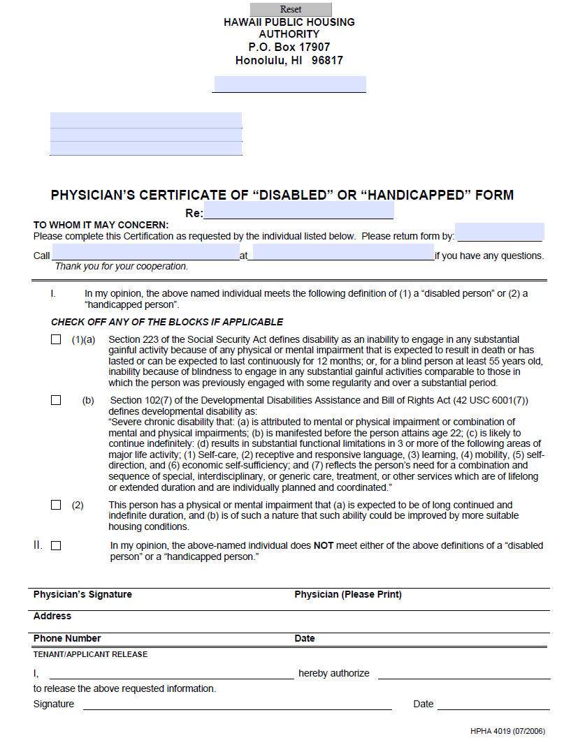

Slide 7
FY 2020 Income Limit Summary (Honolulu) https://www.huduser.gov/portal/datasets/il/il2020/2020summary.odn Applicant’s Gross income may not exceed their family size income limits

Slide 8
Applicants - To Prepare
Have ready
-Full legal name of all family members
-Social Security Numbers
-Birth dates of all family members
-Estimated income of all family members
-Valid mailing address
-Valid email address
If Selected
-Verification of disability
-Valid Photo ID – all adult members
-Proof of birth documentation
-Income documents
-3 Monthly of consecutive paystubs or employment verification of start date, rate of pay, and average hours
-Child Support, Social Security, Pension, etc.
-Asset documents
-Bank statements for all accounts, IRA documentation, life insurance, etc.

Slide 9
Landlord Benefits of the Section 8 Program
Guaranteed Rent
HPHA pays a fixed amount of the rent to participant landlords each month. The tenant pays the difference between the subsidy and the total rent, in addition to any utilities not included in the rent.
Free Inspections
HPHA will inspect your unit to ensure that it is safe, decent, and in good repair. The inspections meet the requirements of the requirements of HUD regulations and City and County of Honolulu ordinances.
Free Listings
Participating landlords may list their rentals with HPHA.
Helping Others in Need
Landlords experience the satisfaction of providing a place to live for low-income families while receiving a dependable source of income

Slide 10
Applying for the waitlist

Slide 11
Interpreter’s will be available on Monday and Tuesday for each waitlist period via zoom to assist applicants with portal and other application questions
HCV Interpreter Schedule
Monday 3/22 | 9 am – 11 am | Marshallese
Monday 3/22 | 1 pm – 3 pm 3 pm – 4:30 pm | Cantonese/Mandarin Vietnamese
Tuesday 3/23 | 9 am – 11 am | Chuukese
Tuesday 3/23 | 1 pm – 3pm | Korean
Palolo Project-Base Interpreter Schedule
Monday 3/29 | 9 am – 11 am | Marshallese
Monday 3/29 | 1 pm – 3 pm 3 pm – 4:30 pm | Cantonese/Mandarin Vietnamese
Tuesday 3/30 | 9 am – 11 am | Chuukese
Tuesday 3/30 | 1 pm – 3pm | Korean
For questions or Reasonable Accommodation Requests needed for applying:
Call (808) 832-6040 or email Hpha.s8waitlist@Hawaii.gov
Schedule and zoom links will be posted online at www.hpha.Hawaii.gov and www.hphaishereforyou.org

Slide 12
A quick walk-through of the online portal www.hpha.myhousing.com
User friendly
Translated into
12 languages
Notes:
Main page provides

Slide 13
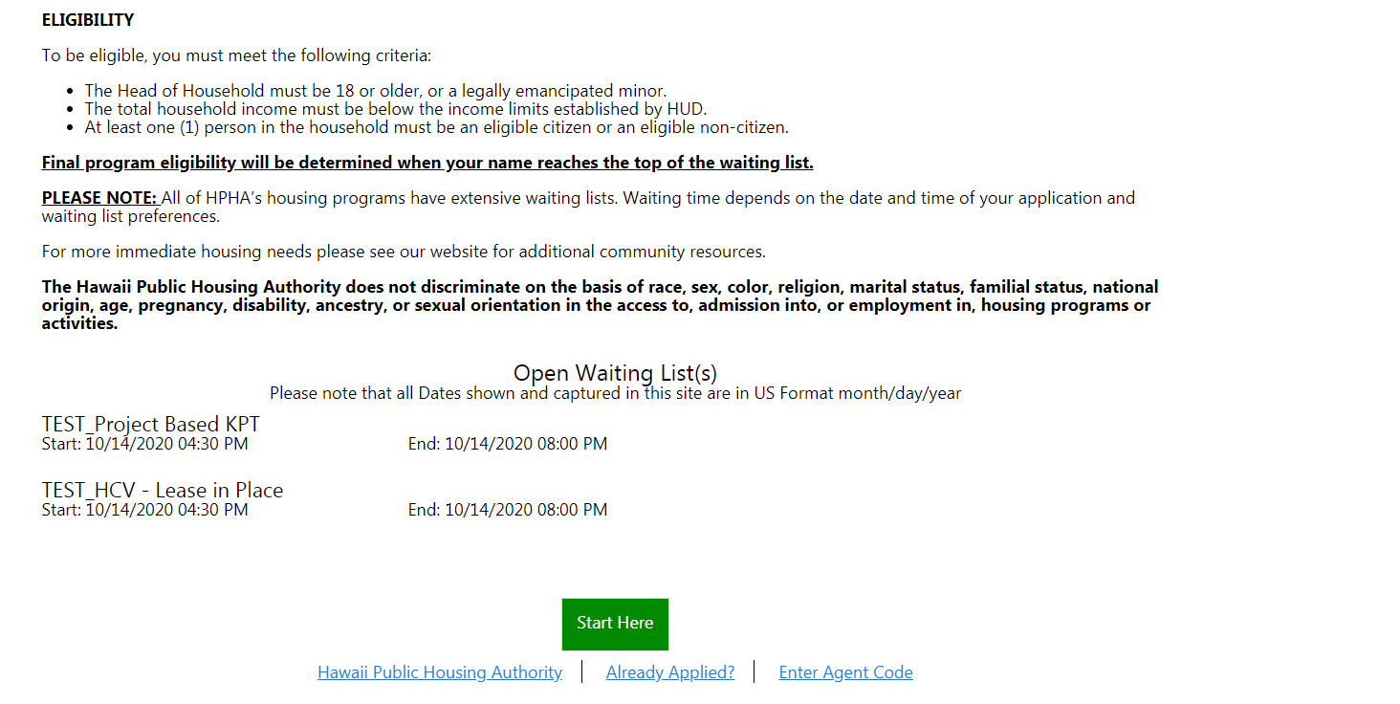

Slide 14
Easy to translate into other languages. Zoom dates have been scheduled to further assist those who need language assistance.

Slide 15
Everything marked in red must be filled out.
Fields will turn green when completed.
Scroll down for more questions

Slide 16
Once completed, applicant will be able to move onto the next page

Slide 17
Number of other members in the household. Applicant does not count themselves

Slide 18
Applicant will answer the same questions for each additional family member.

Slide 19
Insert your Current address

Slide 20
Applicant must report all income individually
Click “Add Income” for each new income source you’re entering

Slide 21
Select the household member you are entering income for.
Select the type of income you are entering, then provide the source and amount
“Other Wage” can be used for all employment income
“Other Non Wage Sources” = Contributions, gifts, etc.
Examples: Parent pays phone bill; friend gives applicant $100/month for necessities

Slide 22
Average gross income (before taxes) and How often you receive that amount
Twice-monthly = paid 2 times a month (SOH pays the 5th and the 20th)
Bi-weekly = every other week (paid every other Friday)

Slide 23
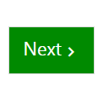
Click “add income” to report additional income. Continue until all income is reported. We recommend applicants collect this information now and keep handy. Deadlines will be firm for submitting information once the applicant is contacted.

Slide 24
Pre-Qualifying question for HCV Preference
If you do not choose “Yes”, you will not qualify for the Non Elderly Disabled Preference

Slide 25
Option for Participants to provide additional contact info.
This portion does not need to be completed at application.

Slide 26
The Optional Contact Form
If you choose to complete the form now, download, fill it out, and upload it into the portal.

Slide 27
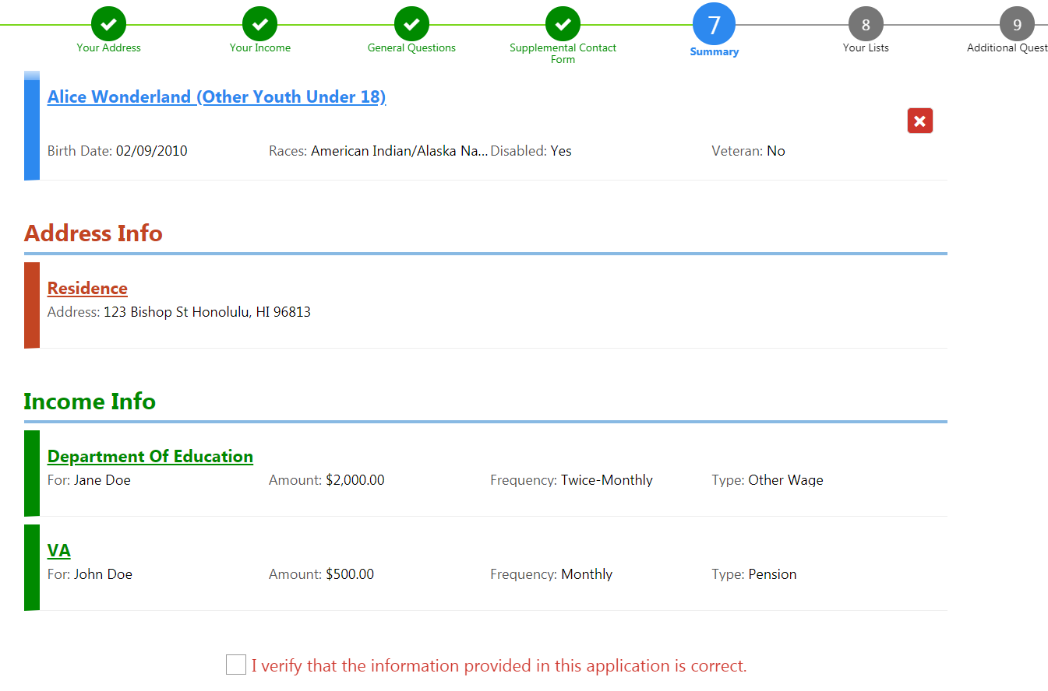
Review your application information. If correct, check the box at the bottom and click “Next”

Slide 28
If you do not meet one of the requirements to apply for a waitlist, you will not be able to apply for it.
Click the “Why” button for an explanation why you do not meet the requirement for a list.

Slide 29
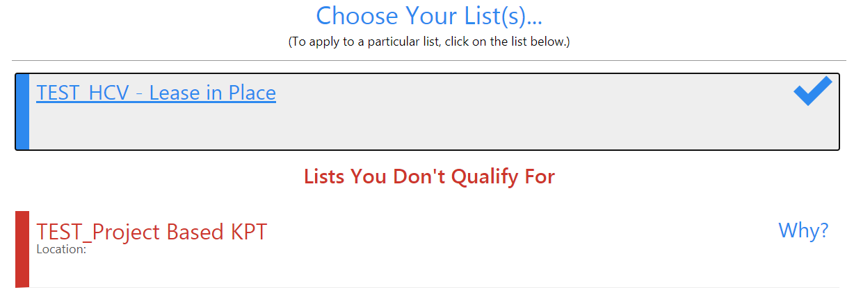
You Must select a list to apply for or you may withdraw your application

Slide 30
Applicant’s can use the “Back” button to correct previous tabs

Slide 31
Preference Question – page 9
Does a member of your family have a disability, and is at least 18 but not yet 62?
Yes – Application will be marked as selecting the preference
No – Will be marked as non-preference

Slide 32
Congratulations! You’ve applied!
If you are a first-time applicant, you may disregard creating a portal account at this time.

Slide 33
Applicants may only apply once. Applicant’s who already have an active HPHA portal account must apply through their account.
Go to “Update Application” to select the waitlist.
You MUST press “SUBMIT” for the application to be submitted.

